Slide 1

IT & DA Team Meeting – July
July 27, 2021

Slide 2
General Updates - Lynn Atkin
July Birthdays & Work Anniversaries - Anurag Rajagopal
LearningHub Overview and Tutorial - Anurag Rajagopal and Moriah Striegel
AIX/UNIX File Systems Application File Review - Ronald Roy
Kaseya Data Breach- Moriah Striegel
Upcoming PTO & Monthly Meeting Presenters – Anurag Rajagopal
Open Forum - Team

Slide 3
General Updates Lynn Atkin

Slide 4

July Birthdays
Eric Mata – July 27th
Prateek Kapoor- July 18th
Nicholas Lombardo- July 11th

Slide 5

July Work Anniversaries
Lynn Atkin – 22 Years - 7/26/1999
Eric Mata - 1 Year – 7/13/2020

Slide 6
Test Your CVS Knowledge

Slide 7
LearningHub Overview and Tutorial
Anurag Rajagopal and Moriah Striegel

Slide 8
LearningHub Overview
Home Tab
Me Tab
Additional Features
Announcements
Discover
Quick Links
Search Bar and Browse
Plan Summary
Plan
Activity
Profile
Completed Learning
Order History
Courses
Groups
Workspaces
Links
Analytics

Slide 9

Home Page
Recommendations
Items on your to-do list
Filtering capabilities
Courses and other resources
Discover
Search Bar and Browse
Announcements
Quick Links
Plan Summary
News for all colleagues
Resources for navigating LearningHub
Links to your groups
Other frequently used pages
Shows overview from “My Plan” tab
Progress tracked

Slide 10
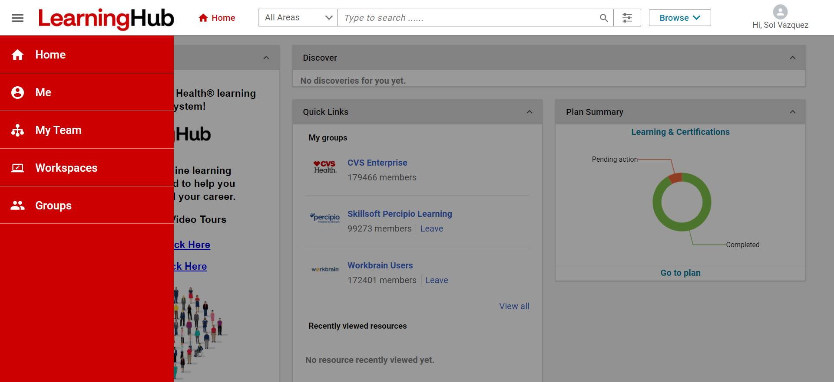
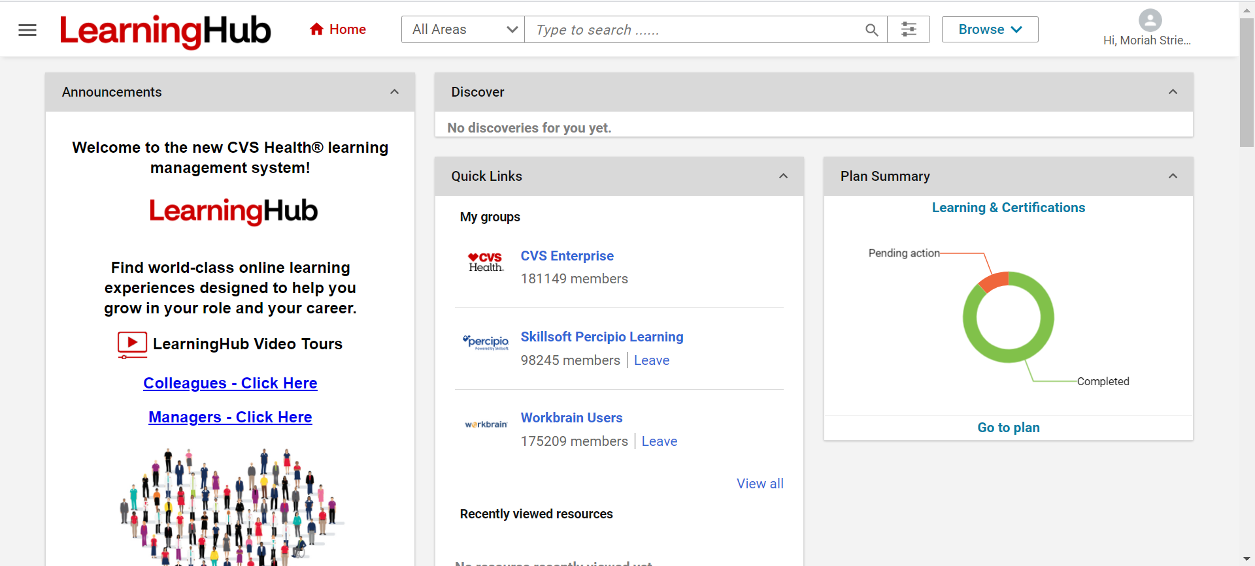
Home Page – How it Looks
Manager View
Colleague View

Slide 11




Me Page
My Plan Tab makes it easy to see an overview of your learning.
The Activity Tab gives a snapshot of your profile, summary, and activity stream.
The Profile Tab shows your goals and other info.
Completed learning and Order History show your past trainings.

Slide 12
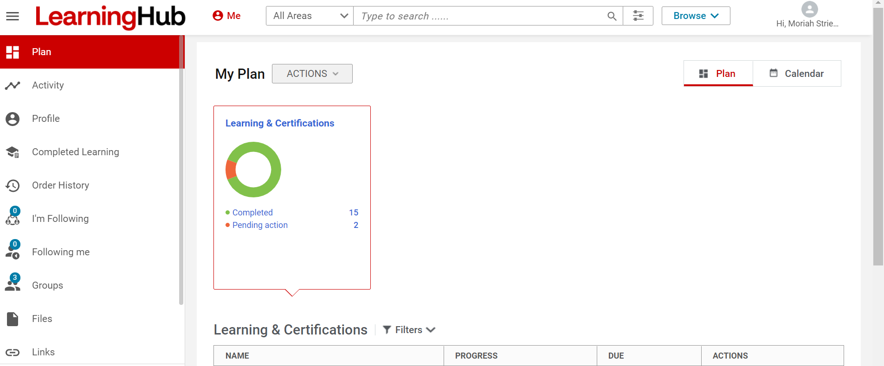
Me Page – How it Looks
1
2
3
5

Slide 13
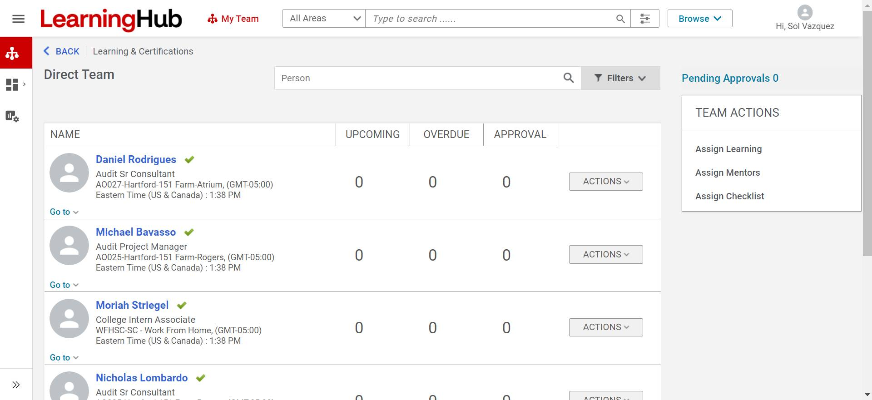
Manager View – Team Tab
1
2
3
5

Slide 14


Additional Features
Courses offer the ability to conduct self-guided learning on a wide variety of topics and learning methods.
Groups allow colleagues to reach out and get connected from anywhere.
Workspaces make it possible to see other topic pages with resources, updates, and materials.
Links is adaptable for each user and their preferred shortcuts.
Analytics provide insights on your learning history.

Slide 15




A digital library is available for internal audit concepts and data analytics software, such as CIA review materials, Data Analytics for Auditors, and Cloud Networking: Understanding Cloud-Based Data Center Networks.
Groups and People help your team stay connected and grow their networks to build teamwork. Create an internal audit group today!
Courses are a great way to deepen your knowledge of internal audit concepts. Some courses we would recommend are Cloud 2021: Cloud Architectures, Identity and Access Services, and CompTIA Cloud+: Data Security and Compliance Controls.
Uses for Your Team

Slide 16


Live Demo
Anurag Rajagopal

Slide 17
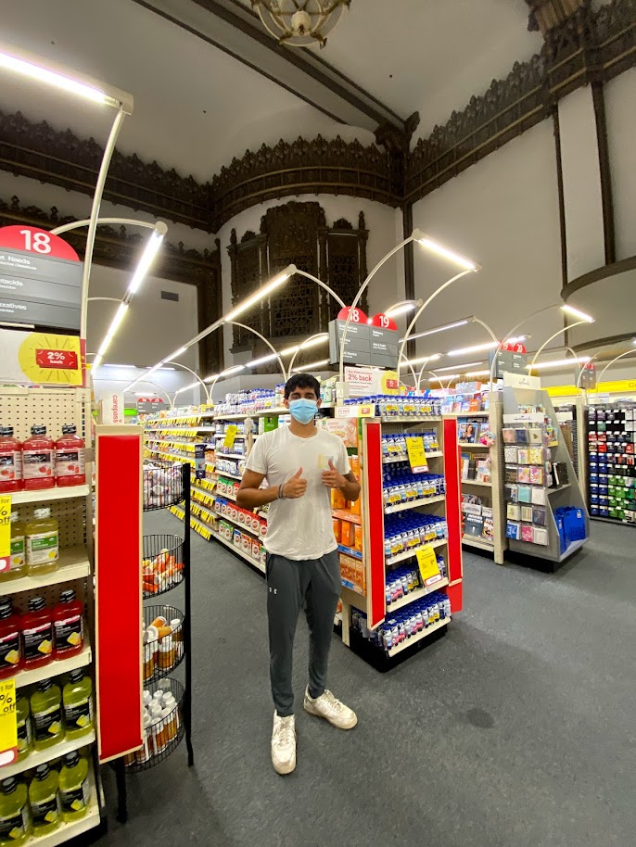
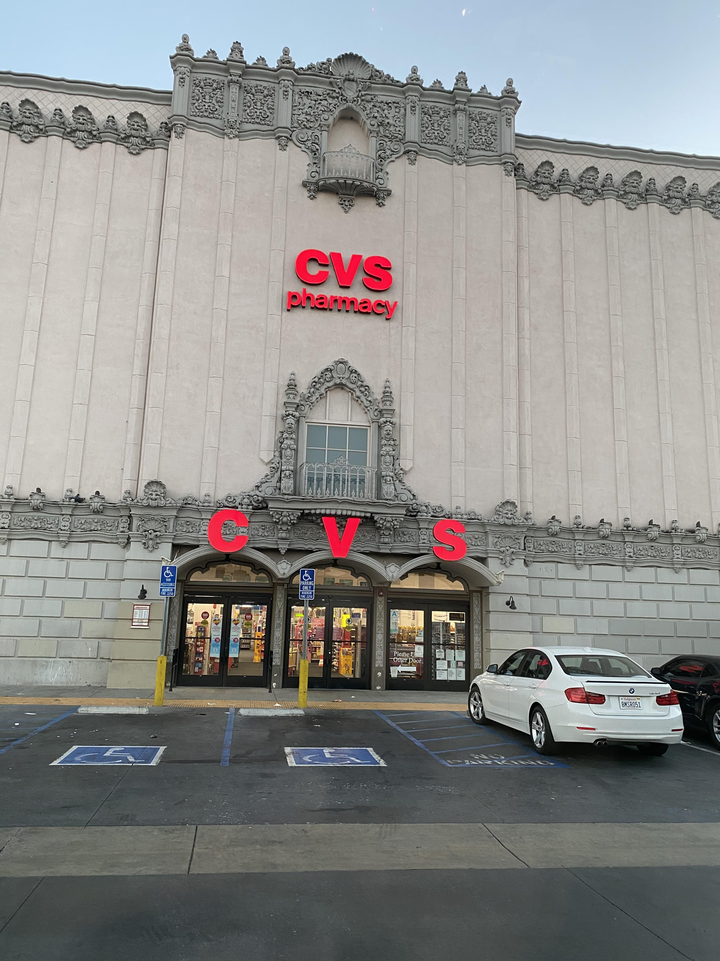

CVS East Los Angeles

Slide 18
AIX/UNIX File Systems Application File Review
Ronald Roy

Slide 19
ISACA Knowledge Quiz

Slide 20
Kaseya Data Breach
Moriah Striegel

Slide 21


The Breach
Kaseya, an IT and data management firm in the U.S., has become the victim in the largest ransomware attack ever.
Attackers hacked into Kaseya’s VSA (Virtual System Administrator) system Friday, July 2, 2020, and the attack became known by Kaseya later that evening.
Kaseya was targeted on this date because attackers knew most U.S. businesses would be out of office for July 4th.
The attackers demanded a ransom of $70 million Bitcoin for the decrypting key to the data.

Slide 22

Initial Statement from Kaseya
July 2, 2021 - 4:00 PM EDT
We are investigating a potential attack against the VSA that indicates to have been limited to a small number of our on-premises customers only. We have proactively shut down our SaaS servers out of an abundance of caution.
We are in the process of investigating the root cause of the incident with the utmost vigilance, we have:
Notified all of our on-premise customers to immediately shutdown their VSA servers
Shutdown our SaaS Servers
We have been further notified by a few security firms of the issue and we are working closely with them as well. While we continue to investigate the incident, we will update our customers (and interested parties) as we have more information.
Sincerely, Kaseya
Kaseya’s other statements and timeline of events can be found here:
https://www.kaseya.com/potential-attack-on-kaseya-vsa/

Slide 23
Impact
The attack was on the VSA service, particularly against on-premise customers.
However, as an extra precaution, Kaseya also shut down their SaaS service on the night of July 2nd until July 5th. This meant Kaseya was almost entirely down for their customers for three days.
It is believed that the attack was triggered with a vulnerability in Kaseya’s authentication process. The weakness allowed the hackers to navigate around authentication controls, upload a malicious payload and execute the commands via SQL injection, allowing access into the system. This is an issue of access management.
60 of 36,000 customers’ data was evaluated as compromised.
While this is not a huge portion of Kaseya’s customer base was directly compromised, the breach resulted in an outage for all customers, and many businesses systems were down until Kaseya was safely restored.
With only 60 of their 36,000 customers affected, Kaseya’s data breach only affected 0.17% of their customer base.

Slide 24
VSA Overview
More charts are available in the chart library on the Brand Center.
Comprehensive IT Management | IT Automation & Efficiency | IT Security | Tremendous ROI
Maintain IT System & Service Availability | Do More with Less | Do More with Less | Stay Secure
Monitor & Manage Get Visibility Easily Generate Reports | Boost IT efficiency Remotely manage Automate IT Processes | Automate Control Access Manage Backups | Priced Right Cost Save Eliminate Tools

Slide 25



Prevention
What would you recommend?
Regular ethical hacking protocols
IDS and IPS implementation
Regular vulnerability scans
Heavier encryption standards for data

Slide 26
Cost of Exposure
What other costs would you consider?
Lost revenue from days offline
Ransomware changes
(i.e. Bitcoin’s traceability)
Reputation damage
Notes:
Bitcoin is irreversible once sent by the sender, and because users are assigned a public key once they log on, they are not using names/etc., allowing them to remain anonymous.

Slide 27

Recent Updates – Kaseya
On July 21, Kaseya announced they had obtained a universal decryption key from a third party, and they would be working to distribute it to their affected customers.
For customers to gain access to the key, Kaseya required the signing of a nondisclosure agreement. This led many to believe Kaseya paid the ransom to the attackers for the decryption key. Kaseya has outwardly denied these claims.
What do you think?

Slide 28

Recent Updates – The Attackers
What do you think?
As of July 13, 2021, the hacker group responsible for the attack on Kaseya has gone dark online.
Their website used to release decryption keys, accept payments, and group correspondence has disappeared.
It is unclear whether this was due to law enforcement intervention at President Biden’s urging or a planned outage by the group.

Slide 29
Sources:
Article by CBS News on the attack:
https://www.cbsnews.com/news/ransomware-attack-revil-hackers-demand-70-million/
Kaseya Press Releases:
https://www.kaseya.com/potential-attack-on-kaseya-vsa
Attackers Go Offline:
https://www.washingtonpost.com/technology/2021/07/13/revil-disappears-kaseya-hack/
Kaseya Denies Paying Ransom:
https://www.zdnet.com/article/kaseya-denies-paying-ransom-for-decryptor-refuses-comment-on-nda/
Questions?

Slide 30



CVS New York Upper West Side

Slide 31
Monthly Meeting Presenters
Upcoming PTO
Name​ | Dates
Eric Baba | July 29,30; Aug 6,12,13,20,26,27
Nick Lombardo | August 2,
Terri Ann Quimbao | July 2, 6
Biven Patel | July 27, August 25
Name​ | Month
Daniel Rodrigues​ | August​

Slide 32
Open Forum

